Slide 1
AOP For You and Me
Matthew D. Groves (@mgroves)

Slide 2
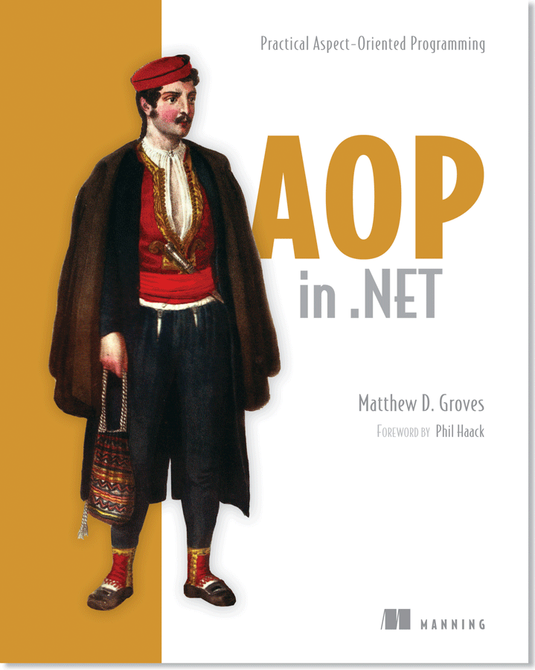
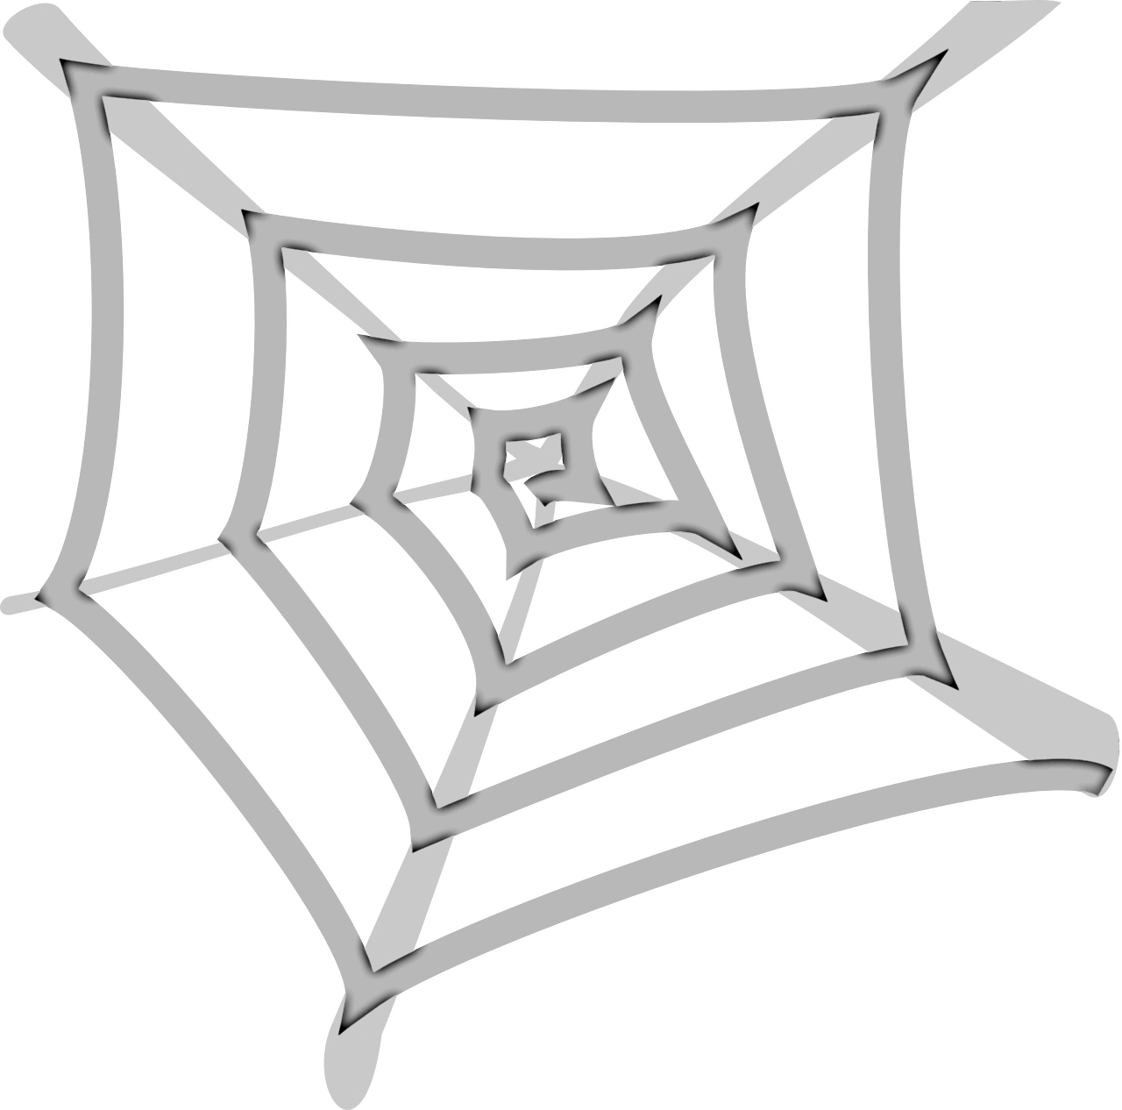
Buy a book
https://www.manning.com/books/aop-in-net
Notes:
This book was published in 2012
So I'm sure many of the code samples are out of date, especially structuremap
Just as an example, I wrote an appendix on installing and using NuGet because it didn't ship with Visual Studio yet
BUT
I had this in mind when I wrote it—so if you want to learn about AOP, I still think it's a good book
That stands the test of time.
At least, that's what I tell people when I want them to buy it.
It's got good reviews, and this is my only plan to put my kids through college, so please buy it

Slide 3

Spaghetti code
http://pixabay.com/en/spaghetti-spaghetti-carbonara-7115/
Notes:
Reduce spaghetti code – cross cutting concerns code that gets tangled up with other code

Slide 4
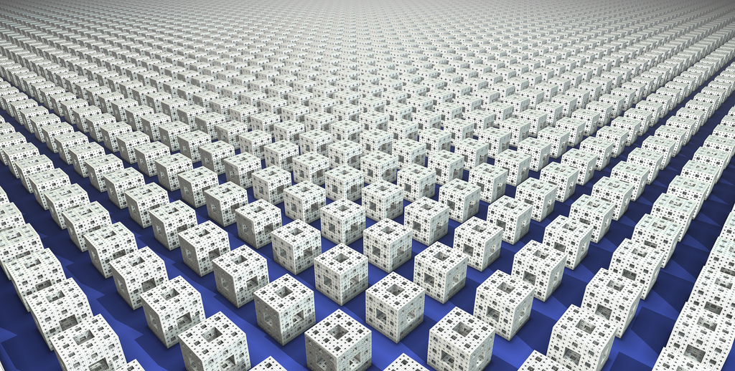
Repetition and boilerplate
http://www.flickr.com/photos/syntopia/6005866895/
Notes:
Reduce repetition and boilerplate – less is more, let’s avoid writing the same thing over and over if we can

Slide 5
AGENDA
01/ | What is AOP for?
02/ | Coding
03/ | Closing / Q&A

Slide 6
Where am I?
Ann Arbor .NET Developers' Group
https://www.meetup.com/aadndevs

Slide 7
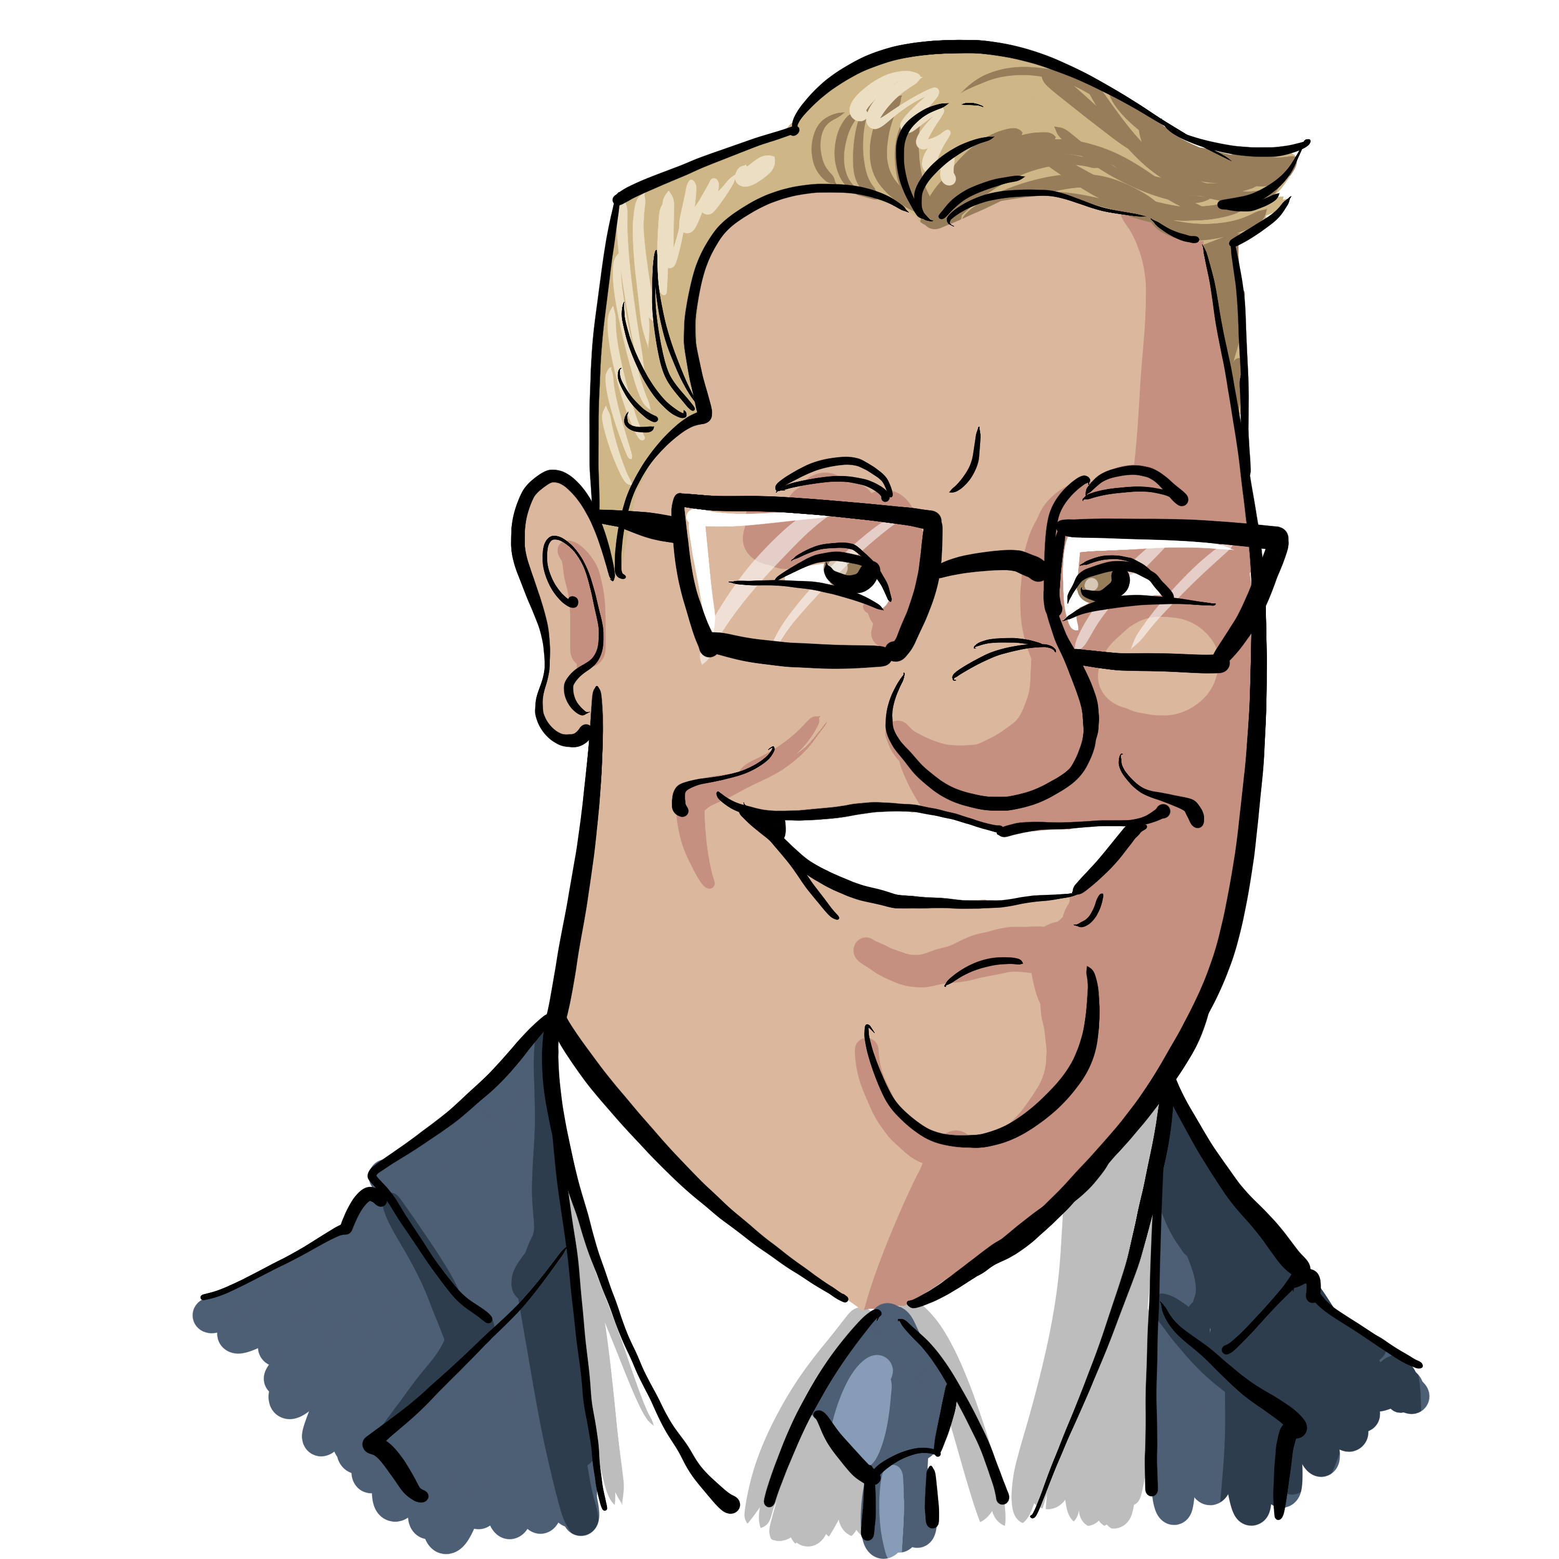
Who am I?
Matthew D. Groves
Developer Advocate for Couchbase
@mgroves on Twitter
Podcast and blog: https://crosscuttingconcerns.com
"I am not an expert, but I am an enthusiast." – Alan Stevens
by @natelovett

Slide 8
AOP For You and Me
Matthew D. Groves (@mgroves)

Slide 9
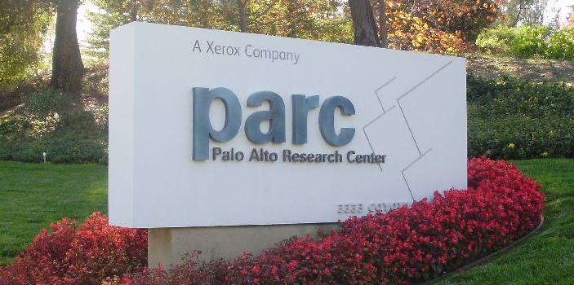
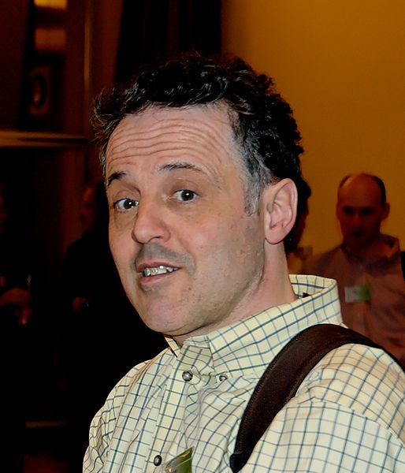
History of AOP
Notes:
Anyone heard of Xerox Parc?
It's the research wing of Xerox that came up with tremendous innovations and influences in computing
Including the GUI, the mouse, ethernet, laser printers, Smalltalk object-oriented programming, model-view-controller
AOP also came out of PARC, albeit much later, with a paper in 1997
Designed by a team lead by this surprised looking man, Gregor Kiczales
As a solution to the problem of bugs increasing over the lifetime of a software project
https://www.flickr.com/photos/sporst/4102709667
https://commons.wikimedia.org/wiki/File:Gregor_Kiczales_AOSD.jpg

Slide 10
What is AOP (for)?
1

Slide 11

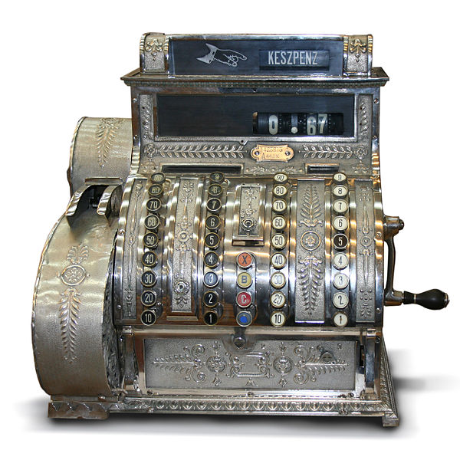
Cross-cutting Concerns
validation
INotifyPropertyChanged
Logging
Transactions
authorization
Caching
Defensive
Programming
exception handling
http://commons.wikimedia.org/wiki/File:Hungarian_Antique_three-column_full-keyboard_cash_register_1902.jpg
http://commons.wikimedia.org/wiki/File:Logging_operations_at_Millmoor_Rig_-_geograph.org.uk_-_530424.jpg
Notes:
Cross-cutting concerns
I often think of these as "non-functional requirements"
These concerns don't meet any of the business requirements themselves, but are vital to the system
They "cut across" the various layers of software
For instance, defensive programming might need to happen in the UI, the backend, the service layer, the data layer, etc

Slide 12
Scattering and Tangling
class BusinessModule1 {
… core data members
… logging members
public Method1() {
… log start
… core operation
… log end
}
public Method2() {
… log start
… core operation
… log end
}
}
class BusinessModule2 {
… core data members
… logging members
public Method1() {
… log start
… core operation
… log end
}
public Method2() {
… log start
… core operation
… log end
}
}
tangling
scattering
logging
logging
*diagram by Xiaoran Wang of programcreek.com

Slide 13
AOP
class BusinessModule1 {
… core data members
public Method1() {
… core operation
}
}
class LogAspect {
… logging members
public BeginMethod() {
… log start
}
public EndMethod() {
… log end
}
}
“weaving”
class BusinessModule1 {
… core data members
… logging members
public Method1() {
… log start
… core operation
… log end
}
}
*diagram by Xiaoran Wang of programcreek.com
Notes:
Aspect-oriented programming introduce the idea of “weaving”
So you take the logging out of the business modules
Put logging into it’s own class, called an “aspect”
Tell the AOP tool which modules that the logging aspect should be applied to
The AOP tool will “weave” them together (possibly right after compiling, possibly at runtime)
The “generated” code still looks and runs basically like it did before
But the code you maintain and work with is nicely separated

Slide 14
Coding
2

Slide 15
Coding AGENDA
01/ | Start with no caching
02/ | Add caching
03/ | Refactor with DI
04/ | Refactor with Decorator
05/ | Refactor with Castle DynamicProxy
06/ | Refactor with PostSharp

Slide 16
Assume you are familiar with…
C# / .NET
ASP.NET Core MVC
Dependency Injection / Inversion
Notes:
If you don't know these things, you will probably be very lost
If you DO know these things, you might still be lost
I haven't really spoken about AOP in years, so *I* might be lost
So please, there is no stupid question. This is a safe place.
But just know that if you are just starting out with any of these things
Then I want you to stay, learn, participate, but DO NOT feel bad that you can't grasp AOP just yet.
Because it is not low hanging fruit. Unit tests, design patterns, naming, communication, these are the things to focus on

Slide 17
Sample Project
ASP.NET Core MVC
Car price/value lookup
Three layers: UI, service, data
Data layer is just supplying random data
Uses Couchbase for caching
Notes:
This project is demo code, it’s contrived
I chose MVC because I’m familiar with it and it makes DI pretty easy, but there’s nothing special about it for this demo
I only have the one service to look up a car price, but try to imagine a bunch of services like it
The service layer does nothing but call the data layer -in a real app it would likely have more logic
I'll use Couchbase as my cache, because it's great for distributed caching, and they're paying for my travel, but there's nothing terribly special about which caching technology I'm using for purposes of this example

Slide 18
CODE

Slide 19
Closing / Q&A
3

Slide 20

Not a silver bullet
https://commons.wikimedia.org/wiki/File:Bullet_coming_from_S%26W.jpg

Slide 21

Unit Testing
http://commons.wikimedia.org/wiki/File:Test_(student_assessment).jpeg
Notes:
If you use a post-compile tool like PostSharp then unit testing is something that requires extra work
Because the code that ultimately gets compiled is all combined into one class
You need a way to manage dependencies, test the aspects, and test code without aspects applied

Slide 22
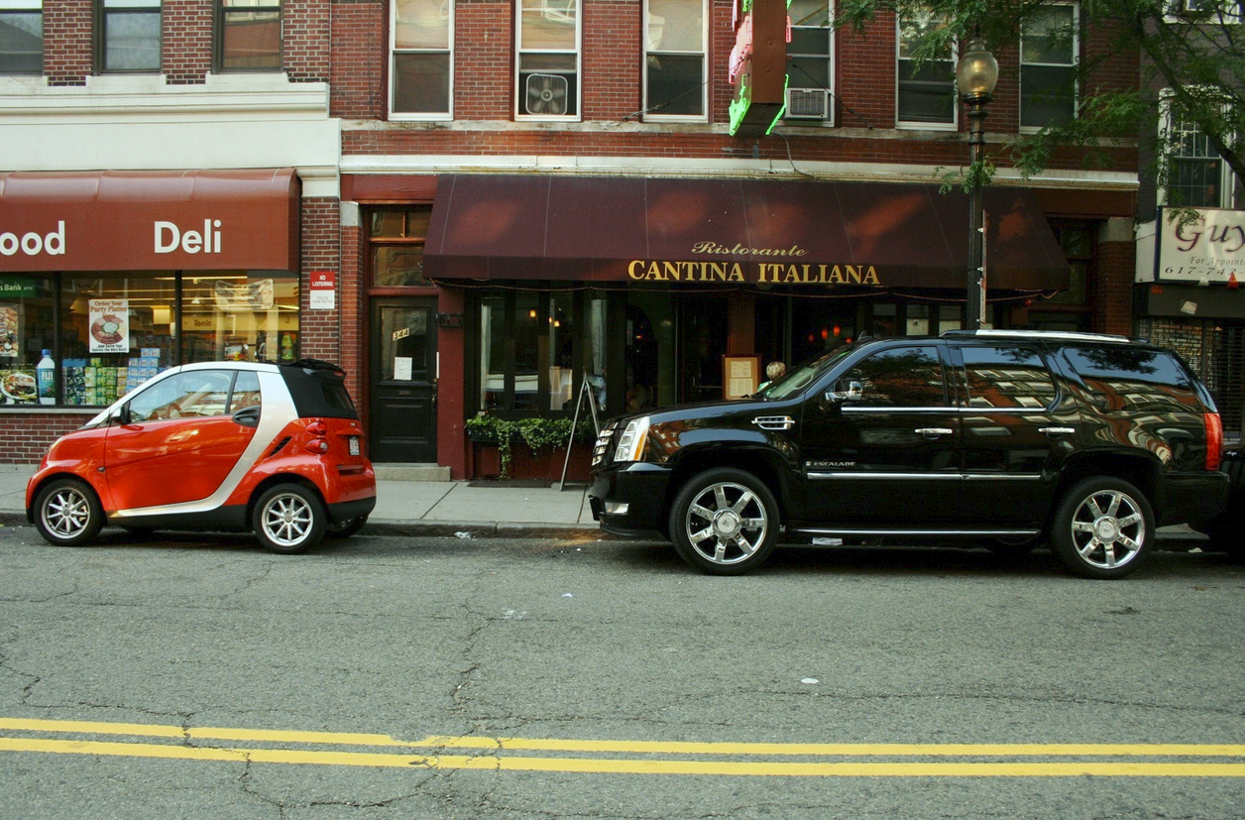
Keep Aspects Thin
C
http://www.fotopedia.com/items/flickr-2683571037

Slide 23
Couchbase Plug
Go to Couchbase.com to download Couchbase
Try out Couchbase on Azure, AWS, GCP (for free!)
Enter to win a $100 gift card here: http://bit.ly/ANNARB18/ (use code ANNARB18)
Notes:
All I ask is that you give Couchbase a chance
Free download
You can also take it for a free test drive on the major cloud providers
Also, this is something new for me this year, please go to this URL to enter to win a $100 gift card. It is literally a 1 question survey and it helps me out a lot.

Slide 24

Where do you find us?
blog.couchbase.com
@mgroves
@couchbasedev
Notes:
This is my family
My enormous head barely fits in the picture

Slide 25
FAQ
Debugging?
Pricing/licensing?
What about ActionFilters / HttpModules / Middleware / Macros?
Other AOP tools?
Roslyn?
Source: https://github.com/mgroves/AOPForYouAndMe
Notes:
Debugging: with castle it's all runtime, so it works how you expect. With PostSharp, it modifies pdb files, so it will also work how you except
Licensing: Not open source. There is a free "postsharp essentials" with some limitations, but everything I've done today should work. There are other editions that contains pre-built aspects ready to use starting at $195 up to $695 per developer.
Castle: Apache License 2.0, open source
What about: I didn't show you ActionFilters or HttpModules or Middleware or Macros, these are all forms of AOP that you may already be using
Other libraries: Spring, Unity -- LinFu & Sheepaspect (don't appear to be active anymore)
More general purpose tools: Fody (appears to still be active), Mono.Cecil (general metaprogramming), Roslyn, Postshark SDK, Microsoft CCI

